Slide 1





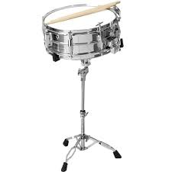


Ridgecrest Music Open House
RIS Music Department
Monday, March 23th, 2020
From 6:00-6:30PM in
Room 102
RSVP If You Are Attending on the Sign Up Genius Link At:
https://www.signupgenius.com/go/30e0f45aaa92da0fa7-ridgecrest1

Slide 2



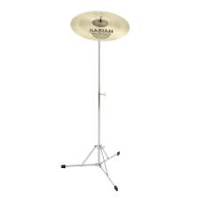



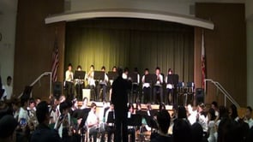
Schools:
Cornerstone
Vista Grande
Soleado
Montemalaga
Pen High School
Music Open House and Auditions at RIS, room 102
Contact Mrs. Lewis-Wang at lewiswang@pvpusd.net

